Slide 1


PROJECT REPORT ON PYTHON & MACHINE LEARNING
COEP Technological University
14 June 2024

Slide 2
OUR TEAM
Team No. 4
Atharva
Pratik
Saurav

Slide 3
Python
LIBRARY MANAGEMENT SYSTEM
COEP Technological University
14 June 2024

Slide 4
INDEX
1. Introduction
2. Project Overview
3. Features and Functionality
4. Code Explanation
- Classes
- Functions and Methods
5. User Interfaces
- Initial Menu
- Admin Menu
- Patron Menu
6. File Operations
7. Security Measures
8. Future Enhancements
9. Conclusion

Slide 5
INTRODUCTION
Develop a library management system to manage
books, patrons, and borrowing activities.
The Library Management System is a software application designed to facilitate the management of books and patrons within a library.
It provides functionalities for managing book inventories, patron records, borrowing, and returning books, and handling overdue fines.
The system also supports basic authentication and role-based access control for patrons and administrators.

Slide 6
2. PROJECT OVERVIEW
This system is built using Python and utilizes CSV files for data storage.
It includes core functionalities like adding, viewing, searching, and deleting books and patrons, as well as borrowing and returning books.
It also manages overdue books and applies fines where applicable.

Slide 7
3. FEATURES & FUNCTIONALITY
Books
Patrons
Administration

Slide 8
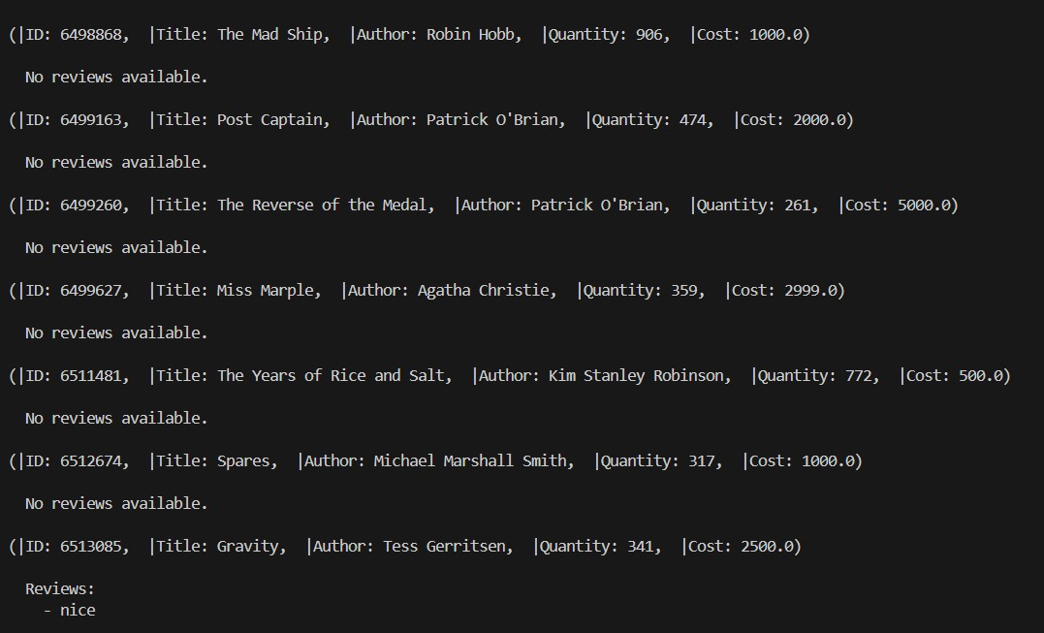
FEATURES & FUNCTIONALITY
3.1 Books
Add, view, search, delete books.
Borrow and return books.
Manage book reviews.

Slide 9
FEATURES & FUNCTIONALITY
3.2 Patrons
Register and manage patrons.
Login and logout functionality.
Role-based access (Admin/Patron).

Slide 10
FEATURES & FUNCTIONALITY
3.3 Administration
Manage book inventory.
View and manage patron records.
Check and handle overdue books.

Slide 11
4. CODE EXPLANATION
1. CLASSES
Book
Patron
Library

Slide 12
CODE EXPLANATION
4.1.1 BOOK
Purpose: The Book class represents a book in a library or inventory system, capturing essential details about the book such as its ID, title, author, quantity, cost, due date, and reviews
Attributes: book_id, title, author, quantity, Cost, due_date, reviews.
Methods: add_review, display_reviews.

Slide 13
CODE EXPLANATION
4.1.2 PATRON
Purpose: The Patron class represents a user (patron) in a library, capturing essential details such as the user's ID, name, email, password, and role.
Attributes: patron_id, name, email, password, role.

Slide 14
CODE EXPLANATION
4.1.3 LIBRARY
Purpose: The library class manages a collection of books, patrons, and the borrowing status of books, providing methods for loading and managing these entities.
Attributes: books, patrons, borrowed_books, current_patron.
Methods: Various methods for loading/saving data, adding/viewing/deleting books and patrons, borrowing/returning books, handling overdue books, etc.

Slide 15
CODE EXPLANATION
2. Functions and Methods
Data Management
Operations
Patron Management
Borrow/Return Book
Overdue Management

Slide 16
5. USER INTERFACES
Initial Menu
Admin Menu
Patron Menu

Slide 17
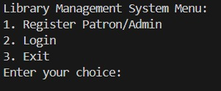
USER INTERFACE
5.1 Initial Menu
Provides options to register or log in:
•1. Register Patron/Admin
•2. Login
•3. Exit

Slide 18
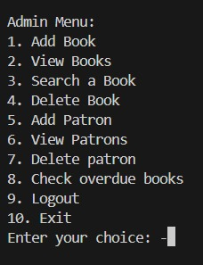
USER INTERFACE
5.2 Admin Menu
Available to logged-in admins:
•1. Add Book
•2. View Books
•3. Search a Book
•4. Delete Book
•5. Add Patron
•6. View Patrons
•7. Delete Patron
•8. Check Overdue Books
•9. Logout
•10. Exit

Slide 19
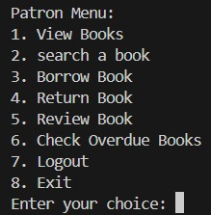
USER INTERFACE
5.3 Patron Menu
Available to logged-in patrons:
•1. View Books
•2. Search a Book
•3. Borrow Book
•4. Return Book
•5. Review Book
•6. Check Overdue Books
•7. Logout
•8. Exit

Slide 20
6. FILE OPERATIONS
The system uses CSV files for data persistence:
1. books.csv: Stores book details.
• - Fields: book_id, title, author, quantity, Cost, reviews, due_date.
2. patrons.csv: Stores patron details.
• - Fields: patron_id, name, email, password, role.
3. borrowed_books.csv: Stores borrowing records
• - Fields: patron_id, book_id, due_date.

Slide 21
7. SECURITY MEASURES
Password Hashing
hash_password = hash.sha256(password.encode()).hexdigest()
# converted into hash.
2.Role Based Access Control

Slide 22
8. FUTURE ENHANCEMENTS
Enhanced User Interface
Email verification function.
Password change option.
Borrow book limit per patron.
In search a book option different genres can be added.
Searching a book using ID or words used in the title.
Fine Calculation

Slide 23
9. CHALLENGES
Password Storage in Hash Form
Upper and Lower Case Management in Searching
Compact and Efficient Code

Slide 24
10. CONCLUSION
By tackling these challenges, we improved our understanding of functions, code management, and CSV file usage. We also learned to effectively link and organize menu systems for a better user interface. Overall, the Library Management System project enhanced our technical skills, problem-solving abilities, and understanding of software development best practices, providing a solid foundation for future projects.

Slide 25
THANK YOU!

Slide 26
Machine Learning
CHAT GPT REVIEWS
COEP Technological University
14 June 2024

Slide 27
INTRODUCTION
Title: ChatGPT Android App Review Analysis
Content:
The ChatGPT Android App leverages OpenAI’s conversational AI, ChatGPT.
Importance of user reviews for feedback and improvements.
Project aims to analyze reviews to understand user sentiment and predict trends.

Slide 28
2. PROBLEM STATEMENT & OBJECTIVES
Problem Statement:
Analyzing user reviews and ratings of the ChatGPT Android App.
Key objectives include visualizing the dataset, understanding its creation, applying machine learning techniques, and reporting results.
Objectives:
Visualize the dataset for distribution and trends.
Explore dataset creation motivations.
Apply machine learning techniques (linear regression, logistic regression, neural networks).
Interpret and report analysis results.

Slide 29
3. SCOPE AND METHODOLOGY
Scope:
Data cleaning, visualization, and machine learning techniques.
Aim: Improve user experience and sentiment understanding.
Methodology:
Data Collection: From Kaggle, “ChatGPT Reviews - Daily Updated”.
Data Preprocessing:
Remove duplicates and irrelevant columns.
Handle missing values by imputing.
Tools & Technologies: Pandas, Matplotlib, Seaborn, Scikit-learn, TensorFlow/Keras, WordCloud, Numpy.

Slide 30
4. MODEL SELECTION AND IMPLEMENTATION
Models Selected:
Logistic Regression - Classify reviews into high/low scores.
Linear Regression - Predict exact rating scores.
Neural Network - Capture non-linear relationships for better predictions.
Implementation:
Logistic Regression: TF-IDF, training, predictions.
Linear Regression: Predict scores, training, predictions.
Neural Network: Build, train, and predict review scores.

Slide 31
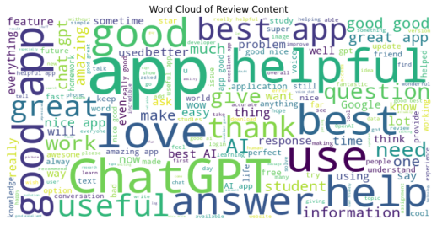
5. DATA VISUALIZATION
Word Cloud:
Visual representation of the most frequent words in reviews.
Code snippet to generate word cloud.

Slide 32
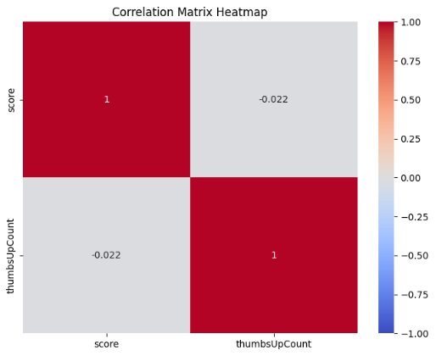
5. DATA VISUALIZATION
Correlation Heatmap:
Shows relationship between review scores and thumbs up.
Code snippet for heatmap generation.

Slide 33
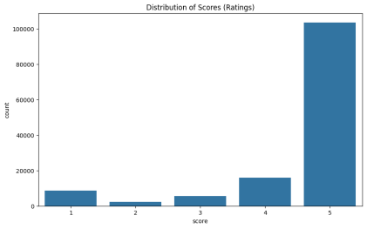
5. DATA VISUALIZATION

Slide 34
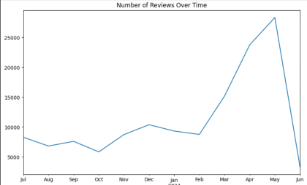
5. DATA VISUALIZATION

Slide 35
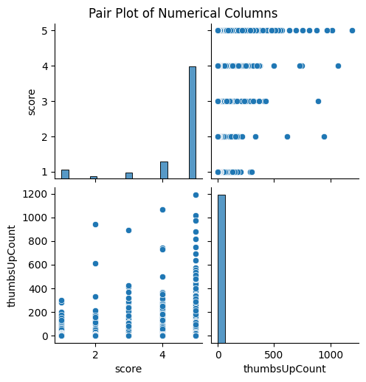
5. DATA VISUALIZATION

Slide 36
6. EXPERIMENTATION & RESULT
Experimental Setup:
Data split into training and testing sets.
Standardized data for uniformity.
Evaluation Metrics:
Accuracy for classification.
Mean Squared Error (MSE) for regression models.
Confusion Matrix for classification evaluation.

Slide 37
7. RESULTS
Performance Metrics:
Logistic Regression Accuracy: 91%
Linear Regression MSE: 0.72
Neural Network MSE: 0.78
Classification Report for Logistic Regression:
High precision, recall, and F1-score for class 1.
Lower performance for class 0.

Slide 38
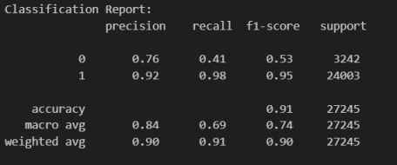
7. RESULTS

Slide 39
8. DISCUSSION
Insights:
Logistic regression effective for classification tasks.
Neural network better for predicting scores.
Useful insights for improving app features and user experience.

Slide 40
9. CONCLUSION
Summary:
Analysis provided valuable insights into user sentiment and app performance.
Visualization techniques aided understanding of data distribution and relationships.
Machine learning models effective in classifying and predicting review scores.
Future Work:
Explore advanced models and techniques.
Real-time analysis and automated feedback systems for instant insights.

Slide 41
10. REFRENCES
Kaggle dataset:
Documentation:
Pandas
Matplotlib,
Seaborn,
Scikit-learn
TensorFlow/Keras
WordCloud
Numpy

Slide 42
THANK YOU!

